Slide 1
MEDIC Guidelines to Reduce Low-Value CXRs in Children with Asthma, Croup, or Bronchiolitis
Supplemental Material
Last updated: 1/26/2023

Slide 2
What is MEDIC?
The Michigan Emergency Department Improvement Collaborative (MEDIC) was launched in 2015 as an emergency physician-led quality improvement Collaborative comprised of hospitals across Michigan.
MEDIC partners with emergency physicians who work together to collect and analyze data, identify best practices based on medical evidence, and improve collective performance.
Participating EDs submit data to a clinical registry maintained by the MEDIC Coordinating Center.
Support for MEDIC is provided by Blue Cross Blue Shield of Michigan and Blue Care Network within the BCBSM Value Partnerships program.

Slide 3
Why Promote ED Guidelines to Reduce Low-Value CXRs in Children with Asthma, Bronchiolitis, & Croup?
Most children with asthma, croup, or bronchiolitis do not benefit from CXR
AAP, Society for Hospital Medicine, & Choosing Wisely discourage routine CXRs in these children
Overuse leads to excess cost, radiation exposure, & overtreatment with antibiotics
Varied experience with & approaches to the care of children
Can result in a lack of standardized approach to care within & between hospitals
Literature-based clinical features can help identify when CXR is low value
Symptoms are regularly encountered in the ED & can overlap with pneumonia
Guidelines may alleviate concerns about missing clinically-significant pneumonia

Slide 4
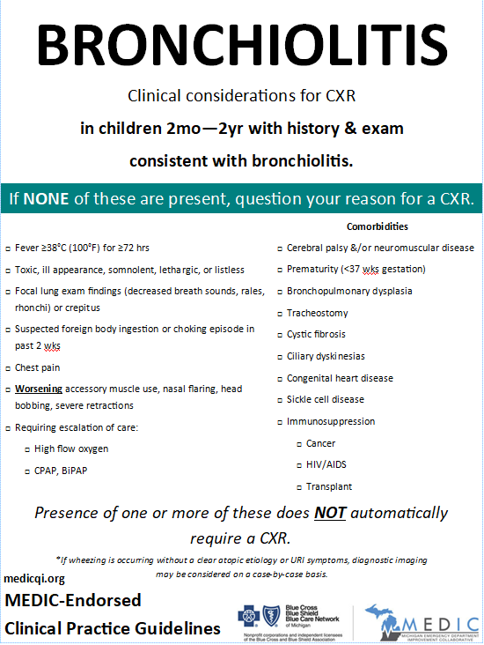
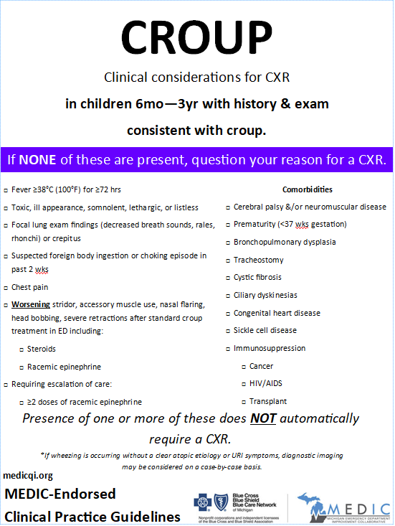
What are these guidelines?
Consensus-driven
Supported by thoughtful review of evidence
Developed for PEM/ED clinicians by:
Practicing ED physicians
From multiple health systems
Across the state of Michigan
To optimize ED use of CXR in children with respiratory illness
Endorsed by MEDIC

Slide 5
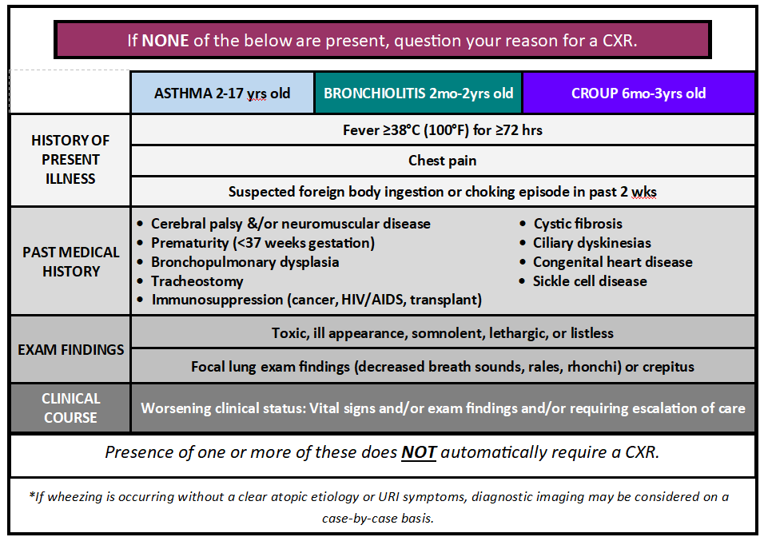
The Guidelines

Slide 6
Why Asthma, Bronchiolitis, & Croup?
GOALS
Reduce CXR utilization & variability of CXR use in common respiratory illnesses seen in EDs
RATIONALE
Asthma, bronchiolitis, & croup are the common respiratory conditions for which children seek emergency care with wide variation in CXR utilization
American Academy of Pediatrics Subcommittee on Diagnosis and Management of Bronchiolitis. Diagnosis and management of bronchiolitis. Pediatrics. 2006 Oct;118(4):1774-93.
Choi J, Lee GL. Common pediatric respiratory emergencies. Emerg Med Clin North Am. 2012 May;30(2):529-63, x.
Florin TA, et al. Viral bronchiolitis. Lancet. 2017 Jan 14;389(10065):211-224
Hanna J, et al. Epidemiological analysis of croup in the emergency department using two national datasets. Int J Pediatr Otorhinolaryngol. 2019 Nov;126:109641.
Mansbach JM, et al. Bronchiolitis in US emergency departments 1992 to 2000: epidemiology and practice variation. Pediatr Emerg Care. 2005 Apr;21(4):242-7.
Richards AM. Pediatric Respiratory Emergencies. Emerg Med Clin North Am. 2016 Feb;34(1):77-96.
Zahran HS, et al. Vital Signs: Asthma in Children - United States, 2001-2016. MMWR Morb Mortal Wkly Rep. 2018 Feb 9;67(5):149-155.
LITERATURE

Slide 7
Why chest x-ray for respiratory illness?
GOALS
Reduce CXR utilization & variability of CXR use in common respiratory illnesses seen in EDs
MEDIC data & literature demonstrate unwarranted variability in CXR use in sites with different patient & provider characteristics
Standard guidance on when a CXR is not likely to reveal clinically-important findings can assist clinicians caring for children in their decision-making processes & reduce variation in care
RATIONALE
National Asthma Education and Prevention Program. Expert panel report 3 (EPR 3): Guidelines for the diagnosis and management of asthma-summary report 2007. J Allergy Clin Immunol. 2007;120:S94-S138.
Petrocheilou A. et al. Viral Croup: diagnosis and a treatment algorithm. Pediatr Pulm. 2014;49(5)
Ralston RL. Et al. Clinical Practice Guideline: The diagnosis, management and prevention of bronchiolitis. From the American Academy of Pediatrics. Pediatrics. November 2014; 134 (5)
Society of Hospital Medicine: Pediatric Hospital Medicine. Choosing Wisely. 2013 February. https://www.choosingwisely.org/clinician-lists/society-hospital-medicine-pediatric-chest-radiographs-for-uncomplicated-asthma-bronchiolitis/.
Shuh S et al. Evaluation of the utility of radiography in acute bronchiolitis. J Pediatr. 2007; 150:429-433
LITERATURE

Slide 8
Why think twice if “NONE of these” are present?
Flip the script – instead of focusing on when to image as the default, guide providers to consider circumstances under which a CXR may not be needed
To signal to providers when a CXR is likely to be low-value
GOALS
MEDIC data registry & the medical literature point to this low risk population of children – with none of a group of concerning clinical factors – in whom a CXR is UNLIKELY to reveal findings that require an alternate management decision
RATIONALE
National Asthma Education and Prevention Program. Expert panel report 3 (EPR 3): Guidelines for the diagnosis and management of asthma-summary report 2007. J Allergy Clin Immunol. 2007;120:S94-S138.
Petrocheilou A. et al. Viral Croup: diagnosis and a treatment algorithm. Pediatr Pulm. 2014;49(5)
Ralston RL. Et al. Clinical Practice Guideline: The diagnosis, management and prevention of bronchiolitis. From the American Academy of Pediatrics. Pediatrics. November 2014; 134 (5)
Society of Hospital Medicine: Pediatric Hospital Medicine. Choosing Wisely. 2013 February. https://www.choosingwisely.org/clinician-lists/society-hospital-medicine-pediatric-chest-radiographs-for-uncomplicated-asthma-bronchiolitis/.
Shuh S et al. Evaluation of the utility of radiography in acute bronchiolitis. J Pediatr. 2007; 150:429-433
LITERATURE

Slide 9
Why “presence of one or more of these does NOT automatically require a CXR”?
GOALS
Obtaining a CXR in children with asthma, bronchiolitis, or croup should not be automatic but thoughtful
Clinicians can & should use a number of factors when deciding to order a CXR for a child with asthma, bronchiolitis, or croup
The decision to order a CXR should be weighed against the likelihood that information from the CXR will change your course of treatment or disposition decision
There is insufficient evidence in the published literature to give a specific weight to the clinical factors that may prompt a CXR
RATIONALE
Shah SN, et al. Does this child have pneumonia? The rational clinical examination systematic review. JAMA. 2017;318(5):462-471.
Chao JH, et al. Predictors of airspace disease on CXR in ED patients with clinical bronchiolitis: A systematic review and meta-analysis. Academic Emergency Medicine Journal. Oct 2016;23(10).
LITERATURE

Slide 10
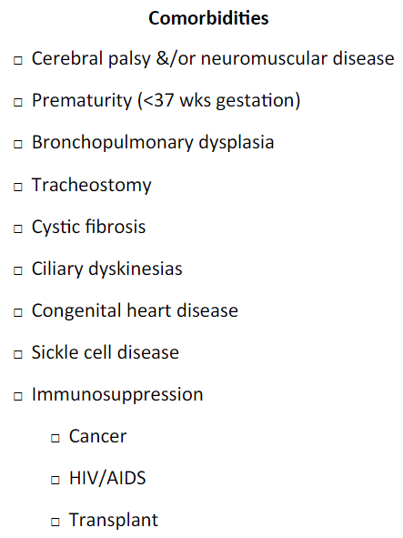
Why these comorbidities?
GOALS
Acknowledge that the decision to order a CXR may be influenced by underlying conditions in children with asthma, bronchiolitis or croup
Identification of certain co morbid conditions that when present in children with asthma, bronchiolitis or croup may require more comprehensive diagnostic evaluation including in some cases a CXR
Presence of these comorbidities does not mean a CXR should be automatically ordered
RATIONALE

Slide 11
What are these guidelines?
Consensus-driven
Supported by thoughtful review of evidence
Developed for PEM/ED clinicians by:
Practicing ED physicians
From multiple health systems
Across the state of Michigan
To optimize ED use of CXR in children with respiratory illness
Endorsed by MEDIC

Slide 12
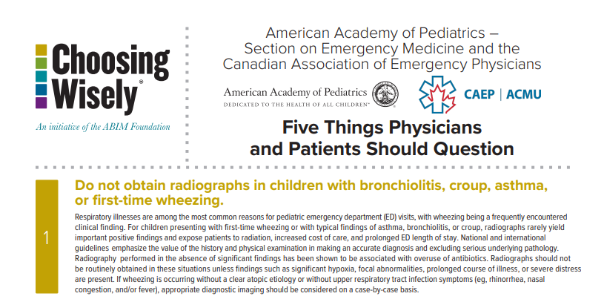
New 2022 pediatric Choosing Wisely guidelines align with MEDIC CXR reduction strategy
American Academy of Pediatrics Subcommittee on Emergency Medicine & Canadian Association of Emergency Physicians. Five Things Physicians & Patients Should Question. Choosing Wisely. 2022 Dec.

Slide 13
MEDIC Guideline Updates: January 2023
MEDIC guidelines are updated as evidence evolves
Recent changes / updates to this MEDIC Toolkit include:
Complaints of chest pain & aerodigestive foreign body applied to all three diagnoses (asthma, bronchiolitis, & croup)
Previously chest pain was only applied to asthma & bronchiolitis and suspicion for aerodigestive foreign body to croup
Changes incorporated based on input from MEDIC Pediatric Committee members
Removal of “first time wheezing” as a potential exception for CXR use (e.g. clinicians may consider this a reasonable cause for CXR order)
With further review, evidence, & endorsed practice from Choosing Wisely national/international recommendations strongly suggest CXRs should no longer be routinely ordered in EDs in this population

Slide 14
Key References
American Academy of Pediatrics Subcommittee on Emergency Medicine & Canadian Association of Emergency Physicians. Five Things Physicians & Patients Should Question. Choosing Wisely. 2022 Dec.
American Academy of Pediatrics Subcommittee on Diagnosis and Management of Bronchiolitis. Diagnosis and management of bronchiolitis. Pediatrics. 2006 Oct;118(4):1774-93.
Chamberlain JM, et al. Practice pattern variation in the care of children with acute asthma. Academic Emergency Medicine Journal. Feb 2016; 23(2).
Chao JH, et al. Predictors of airspace disease on CXR in ED patients with clinical bronchiolitis: A systematic review and meta-analysis. Academic Emergency Medicine Journal. Oct 2016;23(10).
Choi J, Lee GL. Common pediatric respiratory emergencies. Emerg Med Clin North Am. 2012 May;30(2):529-63, x.
Florin TA, et al. Pneumonia in children presenting to the emergency department with asthma exacerbation. JAMA Pediatr. 2016 Aug 1;170(8):803-5.
Florin TA, et al. Viral bronchiolitis. Lancet. 2017 Jan 14;389(10065):211-224.
Hanna J, et al. Epidemiological analysis of croup in the emergency department using two national datasets. Int J Pediatr Otorhinolaryngol. 2019 Nov;126:109641.
Mansbach JM, et al. Bronchiolitis in US emergency departments 1992 to 2000: epidemiology and practice variation. Pediatr Emerg Care. 2005 Apr;21(4):242-7.

Slide 15
Key References cont’d
National Asthma Education and Prevention Program. Expert panel report 3 (EPR 3): Guidelines for the diagnosis and management of asthma-summary report 2007. J Allergy Clin Immunol. 2007;120:S94-S138. This document can also be found here: https://www.nhlbi.nih.gov/health-topics/guidelines-for-diagnosis-management-of-asthma.
Petrocheilou A, et al. Viral Croup: diagnosis and a treatment algorithm. Pediatr Pulm. 2014;49(5).
Ralston RL, et al. Clinical Practice Guideline: The diagnosis, management and prevention of bronchiolitis. From the American Academy of Pediatrics. Pediatrics. November 2014; 134 (5).
Richards AM. Pediatric Respiratory Emergencies. Emerg Med Clin North Am. 2016 Feb;34(1):77-96.
Shah SN, et al. Does this child have pneumonia? The rational clinical examination systematic review. JAMA. 2017;318(5):462-471.
Shuh S, et al. Evaluation of the utility of radiography in acute bronchiolitis. J Pediatr. 2007; 150:429-433
Society of Hospital Medicine: Pediatric Hospital Medicine. Choosing Wisely. 2013 February. https://www.choosingwisely.org/clinician-lists/society-hospital-medicine-pediatric-chest-radiographs-for-uncomplicated-asthma-bronchiolitis/.
Trottier ED, Chan K, Allain D, Chauvin-Kimoff L. Managing an acute asthma exacerbation in children. Paediatr Child Health. 2021;26(7):438-439. DOI: 10.1093/pch/pxab058
Zahran HS, et al. Vital Signs: Asthma in Children - United States, 2001-2016. MMWR Morb Mortal Wkly Rep. 2018 Feb 9;67(5):149-155.

